Slide 1


Fuge Zou
12/16/2021

Slide 2

Outline
Executive Summary
Introduction
Methodology
Results
Conclusion
Appendix

Slide 3
Executive Summary
Summary of methodologies
Data collection
Data Wrangling
Exploratory Data Analysis (EDA) with data visualization
Exploratory Data Analysis (EDA) with SQL
Building an interactive map with Folium
Building a Dashboard with Plotly Dash
Predicted Analysis of Success Rate
Summary of all results
Exploratory Data Analysis (EDA) results
Interactive analytics dashboard
Machine learning resutls

Slide 4
Introduction
Project background and context
We get data from SpaceX website with all their launching and landing information. Our goal is trying to collect, clean, model the data so we can learn what makes a successful landing.
Problems you want to find answers
What is the driver for a successful landing
Is there any trend or business insights on the landing performance
How can we make the landing more successful in the future

Slide 5


Slide 6
Methodology
Executive Summary
Data collection methodology:
Using the SpaceX Rest API and Wikipedia combined
Perform data wrangling
We clean the data using Pandas library, and we made the categorical variables one-hot encoding by calling the pd.get_dummies() function
Perform exploratory data analysis (EDA) using visualization and SQL
Perform interactive visual analytics using Folium and Plotly Dash
Perform predictive analysis using classification models
I have tested KNN, Decision Tree, SVM and Logistic Regression ‘
I have done hyperparameter tuning using GridSearchCV

Slide 7
Data Collection
Describe how data sets were collected.
I downloaded data using SpaceX Rest API and Wikipedia
You need to present your data collection process use key phrases and flowcharts
SpaceX Rest API
Space X API
JSON File
Pandas
Wikipedia
HTML
Beautiful Soup
Pandas

Slide 8
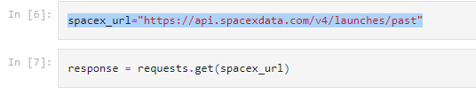
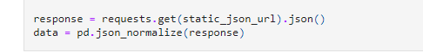
Data Collection – SpaceX API
https://github.com/fenixchow/IBM_Final_Capstone_Project/blob/main/jupyter-labs-spacex-data-collection-api.ipynb
Present your data collection with SpaceX REST calls using key phrases and flowcharts
Add the GitHub URL of the completed SpaceX API calls notebook (must include completed code cell and outcome cell), as an external reference and peer-review purpose
- Getting Response
- Put the data into Pandas

Slide 9
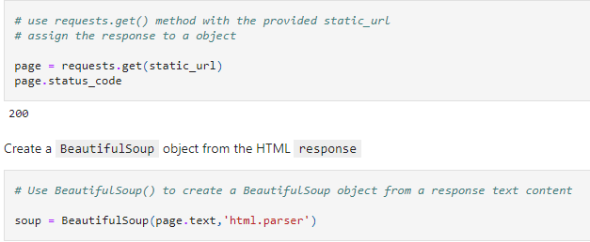
Data Collection - Scraping
https://github.com/fenixchow/IBM_Final_Capstone_Project/blob/main/jupyter-labs-webscraping.ipynb
Present your web scraping process using key phrases and flowcharts
Add the GitHub URL of the completed web scraping notebook, as an external reference and peer-review purpose
- Using Beautiful Soup

Slide 10
Data Wrangling
https://github.com/fenixchow/IBM_Final_Capstone_Project/blob/main/labs-jupyter-spacex-Data%20wrangling.ipynb
Perform Exploratory Data Analysis EDA on dataset
Calculate the number of launches at each site
Calculate the number and occurrence of each orbit
Calculate the number and occurrence of mission outcome per orbit type
Create a landing outcome label from Outcome column

Slide 11
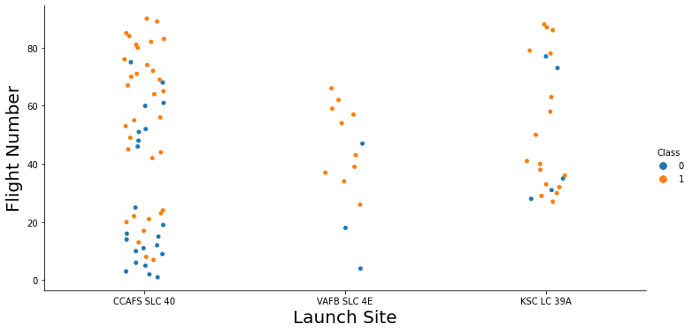
EDA with Data Visualization
https://github.com/fenixchow/IBM_Final_Capstone_Project/blob/main/jupyter-labs-eda-dataviz.ipynb

Slide 12
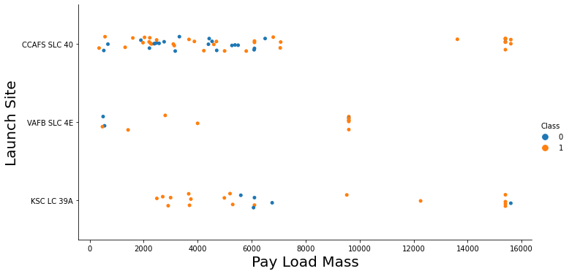
EDA with Data Visualization
https://github.com/fenixchow/IBM_Final_Capstone_Project/blob/main/jupyter-labs-eda-dataviz.ipynb

Slide 13
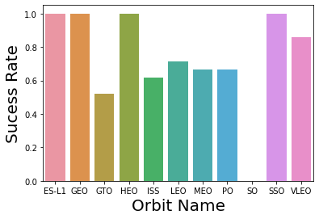
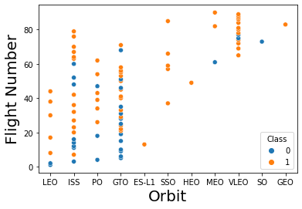
EDA with Data Visualization
https://github.com/fenixchow/IBM_Final_Capstone_Project/blob/main/jupyter-labs-eda-dataviz.ipynb

Slide 14
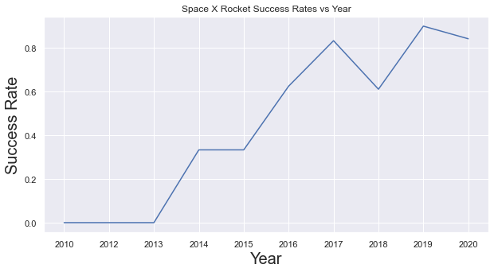
EDA with Data Visualization
https://github.com/fenixchow/IBM_Final_Capstone_Project/blob/main/jupyter-labs-eda-dataviz.ipynb

Slide 15
EDA with SQL
https://github.com/fenixchow/IBM_Final_Capstone_Project/blob/main/jupyter-labs-eda-sql-coursera.ipynb
Finished 10 Task on SQL to further explore the SpaceX Dataset
Used IBM DB2 as the cloud database
Used Python to call IBM DB2 using the magic SQL command
Check the GitHub for details

Slide 16
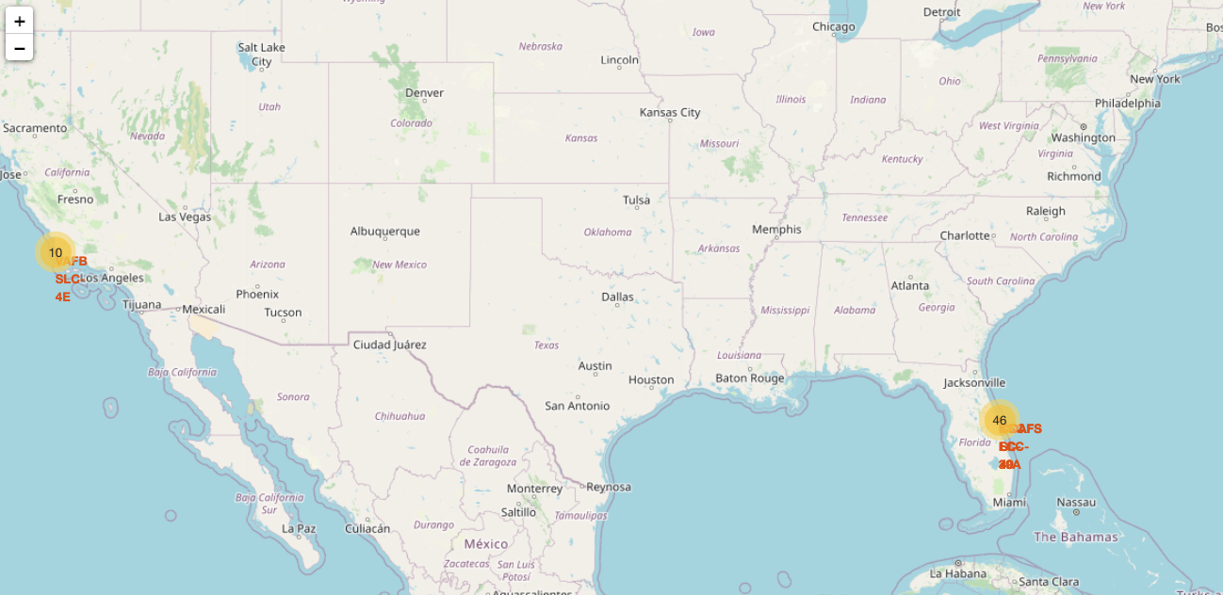
Build an Interactive Map with Folium
https://github.com/fenixchow/IBM_Final_Capstone_Project/blob/main/lab_jupyter_launch_site_location.ipynb

Slide 17
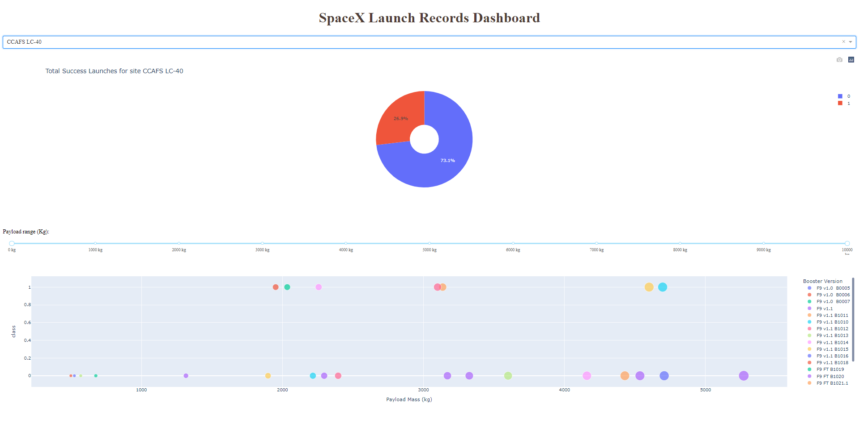
Build a Dashboard with Plotly Dash
https://github.com/fenixchow/IBM_Final_Capstone_Project/blob/main/Interactive_Dashboard_w_Ploty_Dash.ipynb

Slide 18
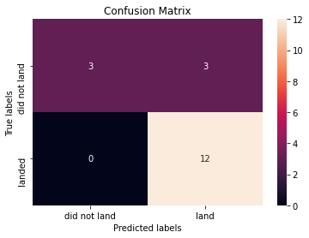
Predictive Analysis (Classification)
https://github.com/fenixchow/IBM_Final_Capstone_Project/blob/main/SpaceX_Machine%20Learning%20Prediction_Part_5.ipynb
I used SVM, Logistic Regression, Decision Tree and KNN model, the best results on test data is decision tree with a score of 87.7%

Slide 19
Results
Exploratory data analysis results
Interactive analytics demo in screenshots
Predictive analysis results

Slide 20


Slide 21
Flight Number vs. Launch Site

Slide 22
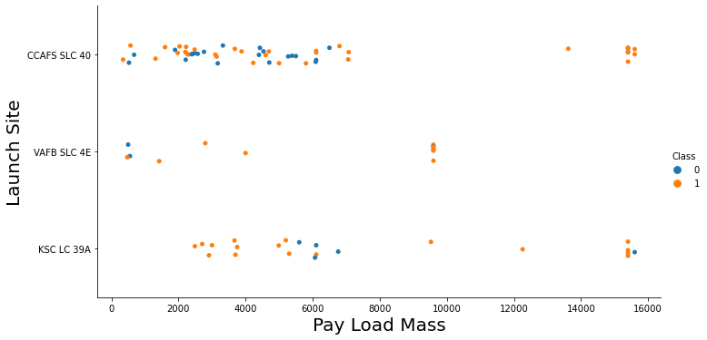
Payload vs. Launch Site

Slide 23
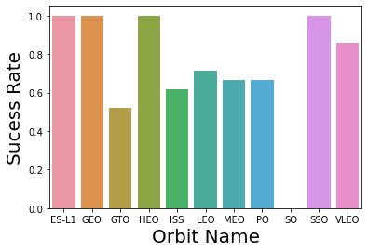
Success Rate vs. Orbit Type

Slide 24
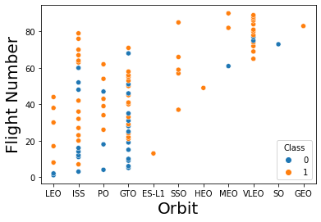
Flight Number vs. Orbit Type

Slide 25
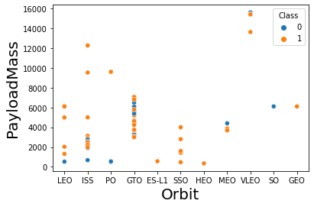
Payload vs. Orbit Type

Slide 26
Launch Success Yearly Trend

Slide 27
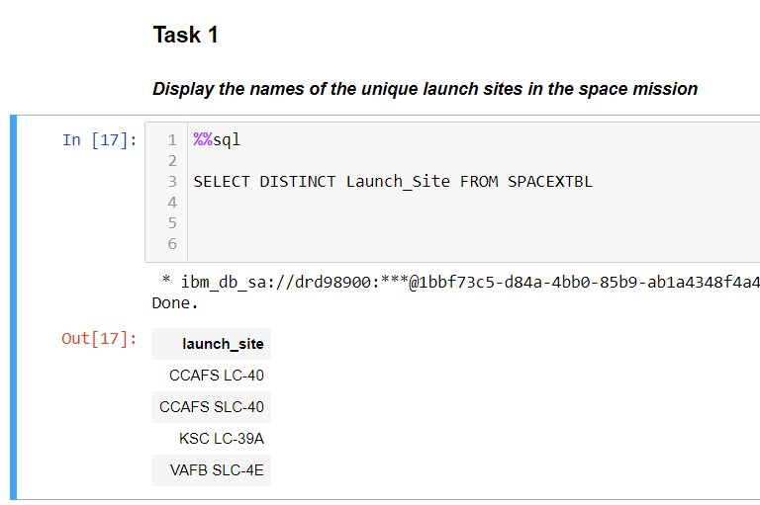
All Launch Site Names

Slide 28
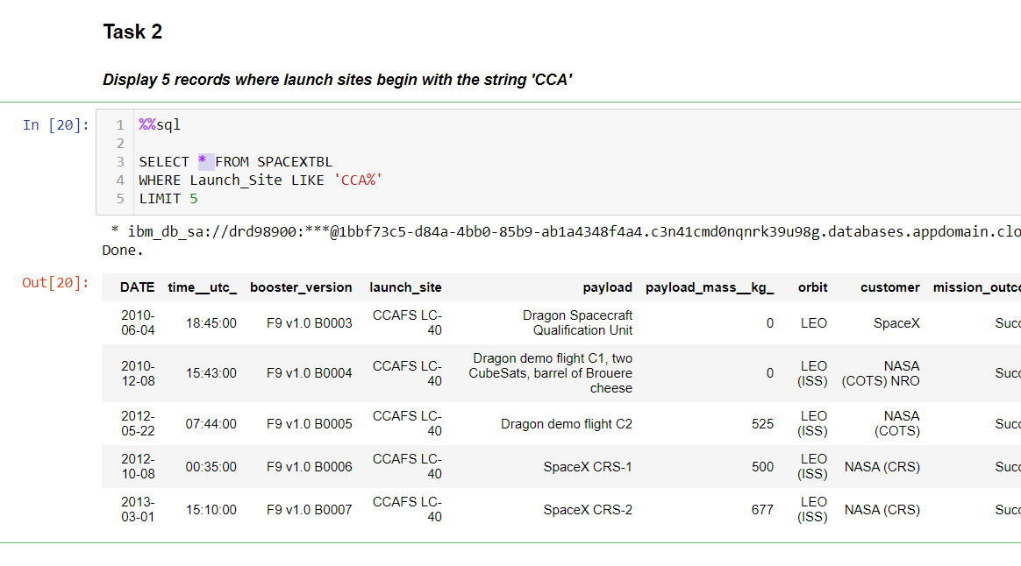
Launch Site Names Begin with 'CCA'

Slide 29
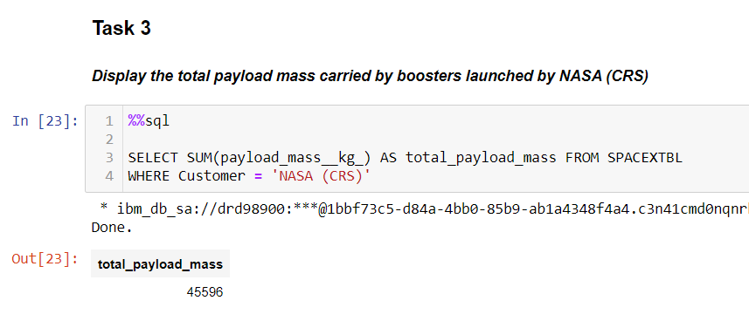
Total Payload Mass

Slide 30
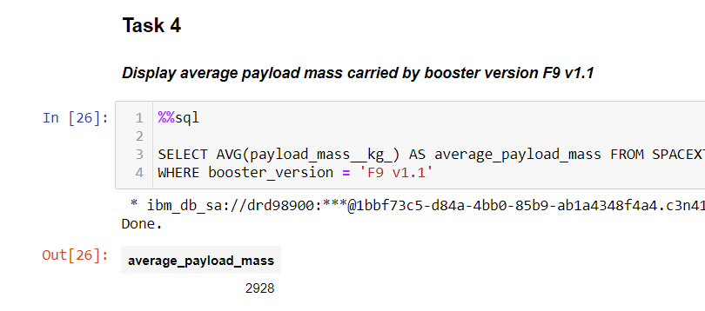
Average Payload Mass by F9 v1.1

Slide 31
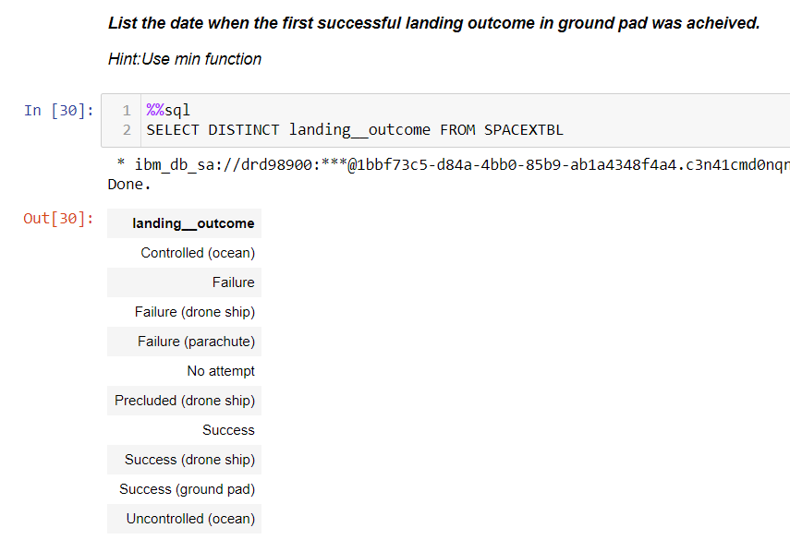
First Successful Ground Landing Date

Slide 32
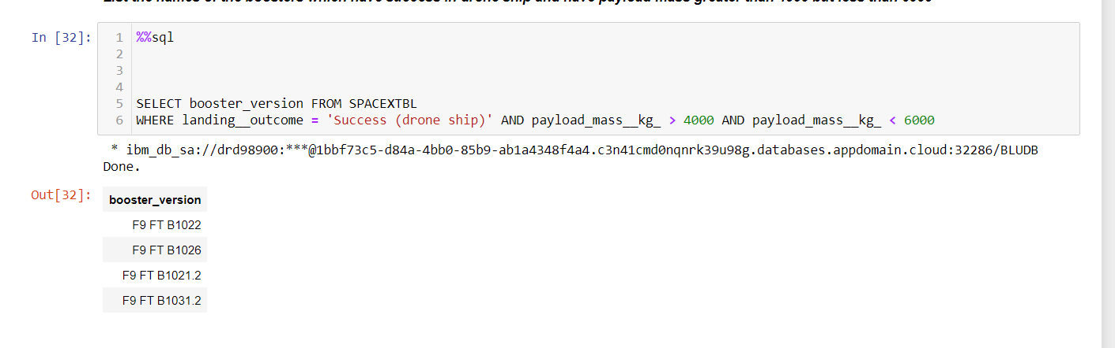
Successful Drone Ship Landing with Payload between 4000 and 6000

Slide 33
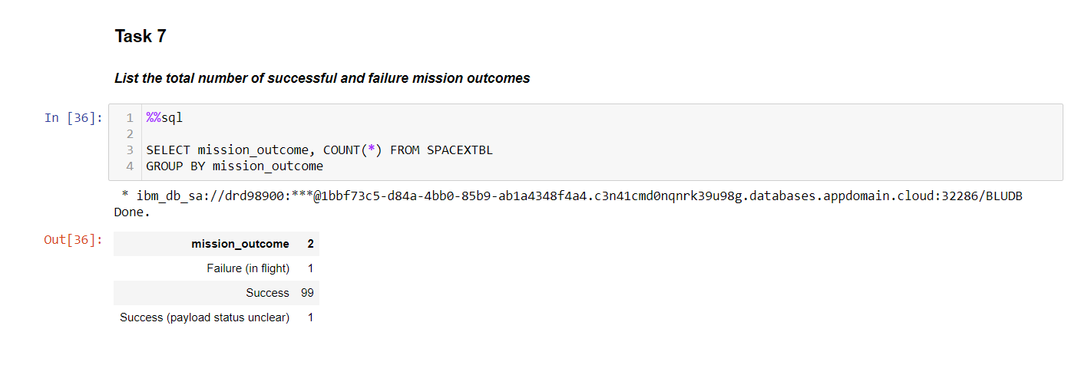
Total Number of Successful and Failure Mission Outcomes
Calculate the total number of successful and failure mission outcomes
Present your query result with a short explanation here

Slide 34
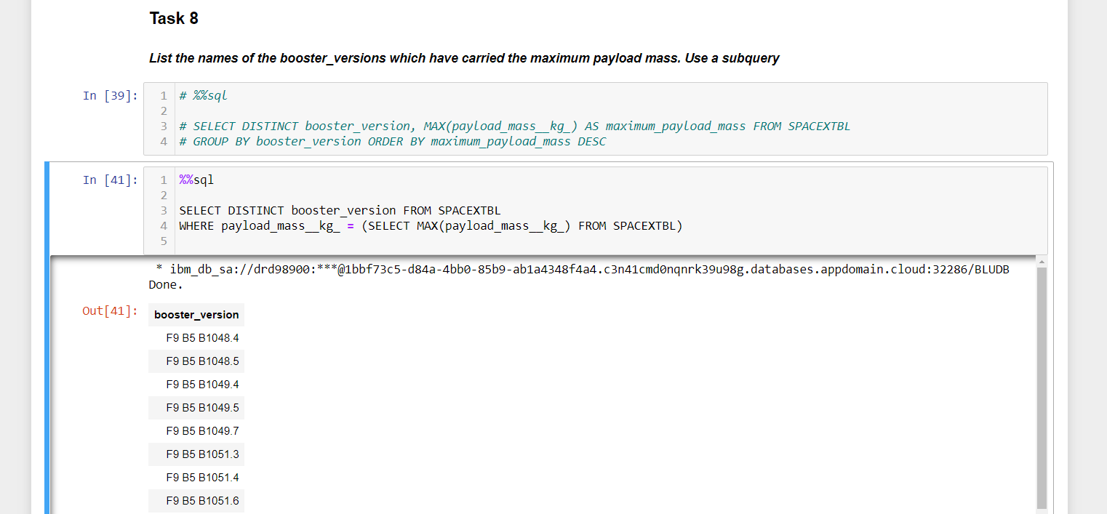
Boosters Carried Maximum Payload
List the names of the booster which have carried the maximum payload mass
Present your query result with a short explanation here

Slide 35
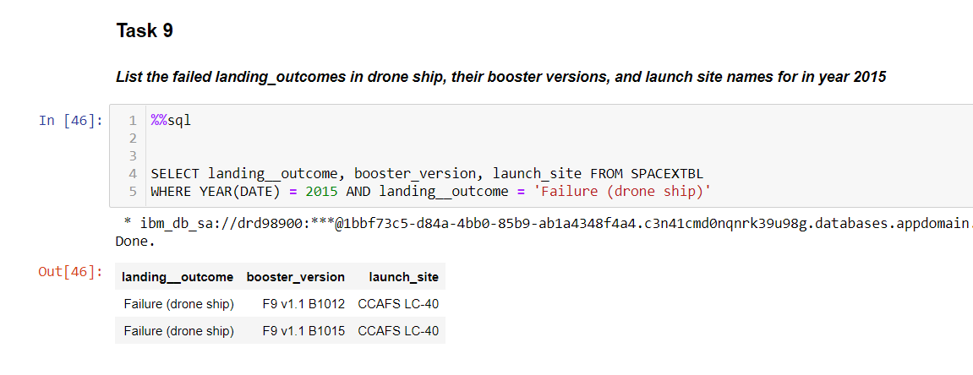
2015 Launch Records

Slide 36
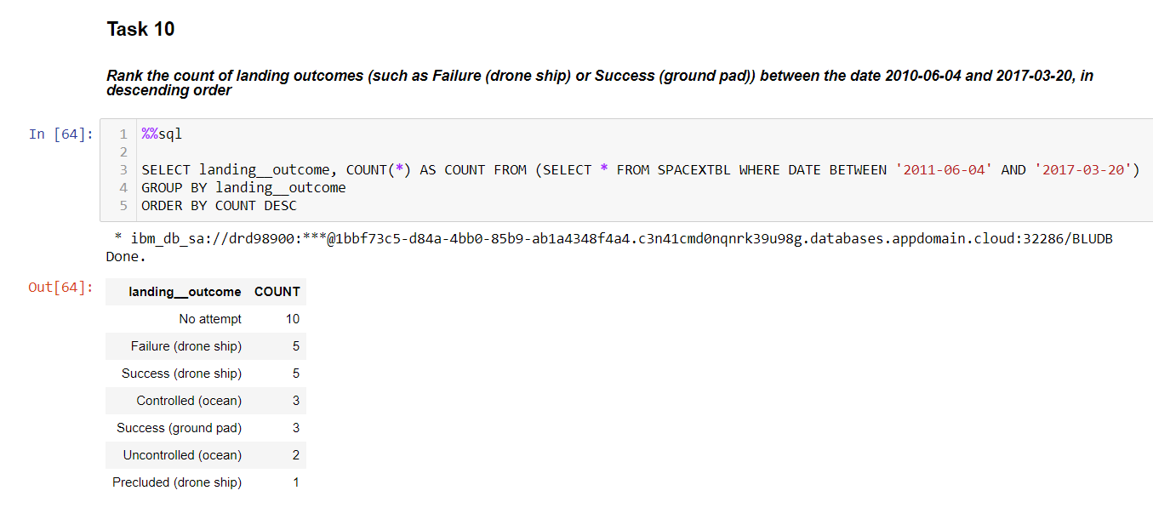
Rank Landing Outcomes Between 2010-06-04 and 2017-03-20
Rank the count of landing outcomes (such as Failure (drone ship) or Success (ground pad)) between the date 2010-06-04 and 2017-03-20, in descending order
Present your query result with a short explanation here

Slide 37


Slide 38
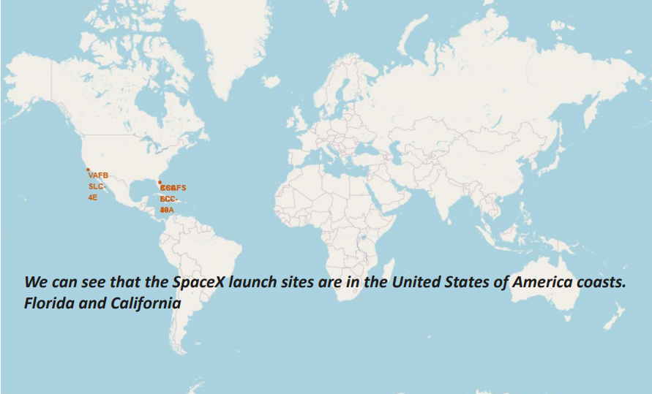
<Folium Map Screenshot 1>
Replace <Folium map screenshot 1> title with an appropriate title
Explore the generated folium map and make a proper screenshot to include all launch sites’ location markers on a global map
Explain the important elements and findings on the screenshot

Slide 39
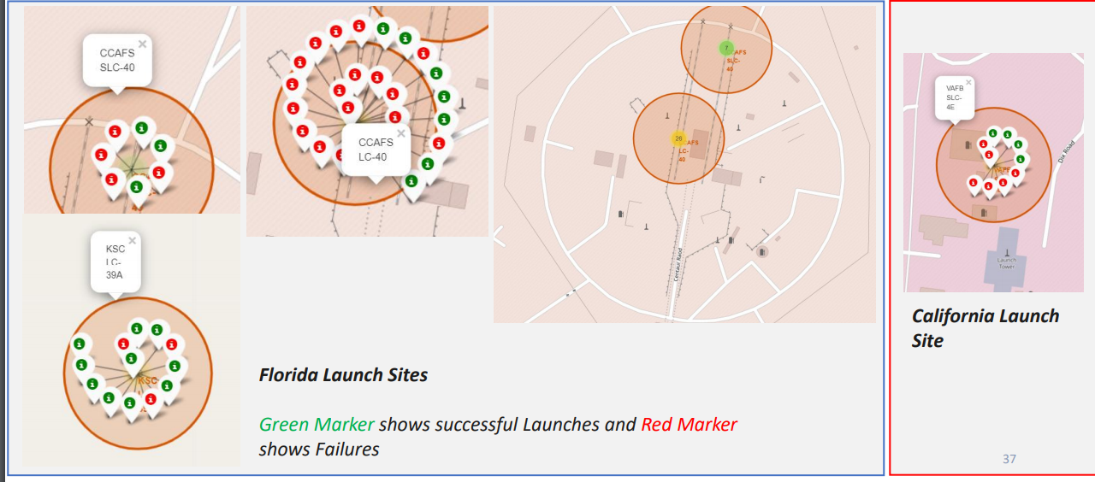
<Folium Map Screenshot 2>
Replace <Folium map screenshot 2> title with an appropriate title
Explore the folium map and make a proper screenshot to show the color-labeled launch outcomes on the map
Explain the important elements and findings on the screenshot

Slide 40
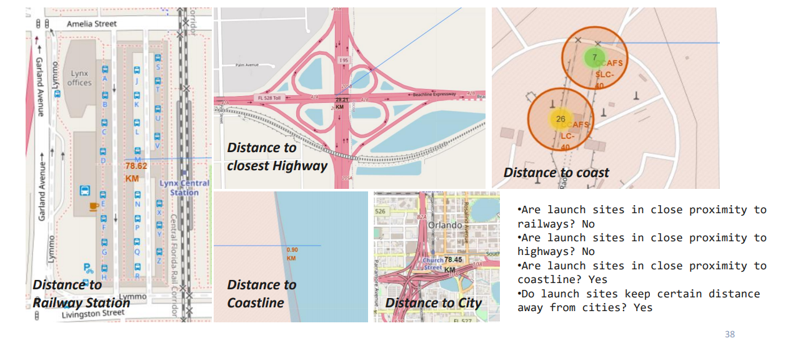
<Folium Map Screenshot 3>
Replace <Folium map screenshot 3> title with an appropriate title
Explore the generated folium map and show the screenshot of a selected launch site to its proximities such as railway, highway, coastline, with distance calculated and displayed
Explain the important elements and findings on the screenshot

Slide 41


Slide 42
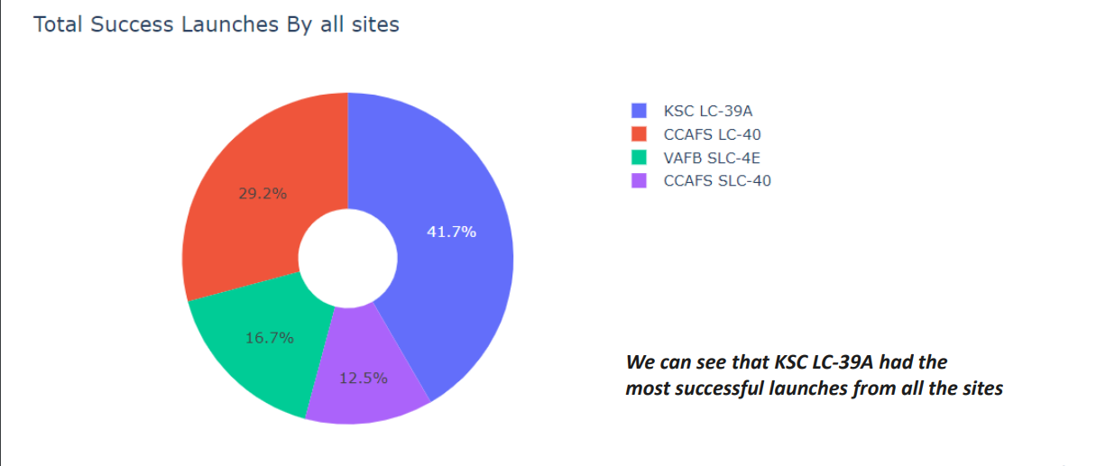
<Dashboard Screenshot 1>
Replace <Dashboard screenshot 1> title with an appropriate title
Show the screenshot of launch success count for all sites, in a piechart
Explain the important elements and findings on the screenshot

Slide 43
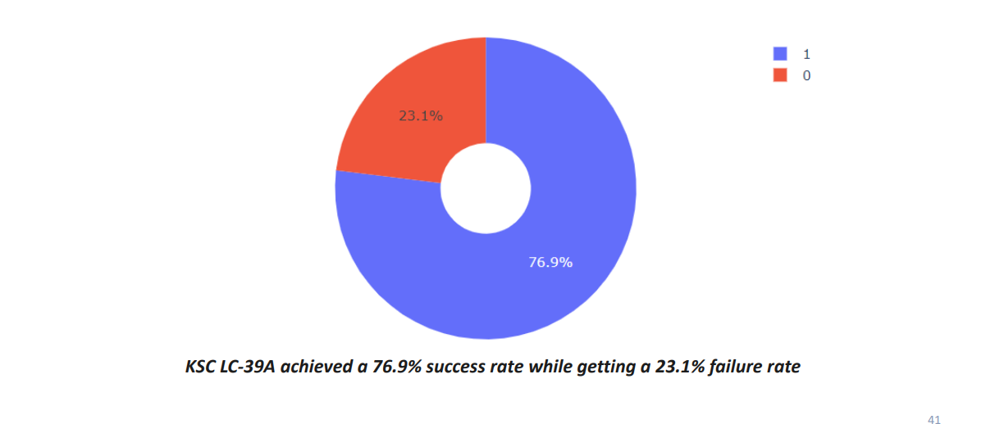
<Dashboard Screenshot 2>
Replace <Dashboard screenshot 2> title with an appropriate title
Show the screenshot of the piechart for the launch site with highest launch success ratio
Explain the important elements and findings on the screenshot

Slide 44
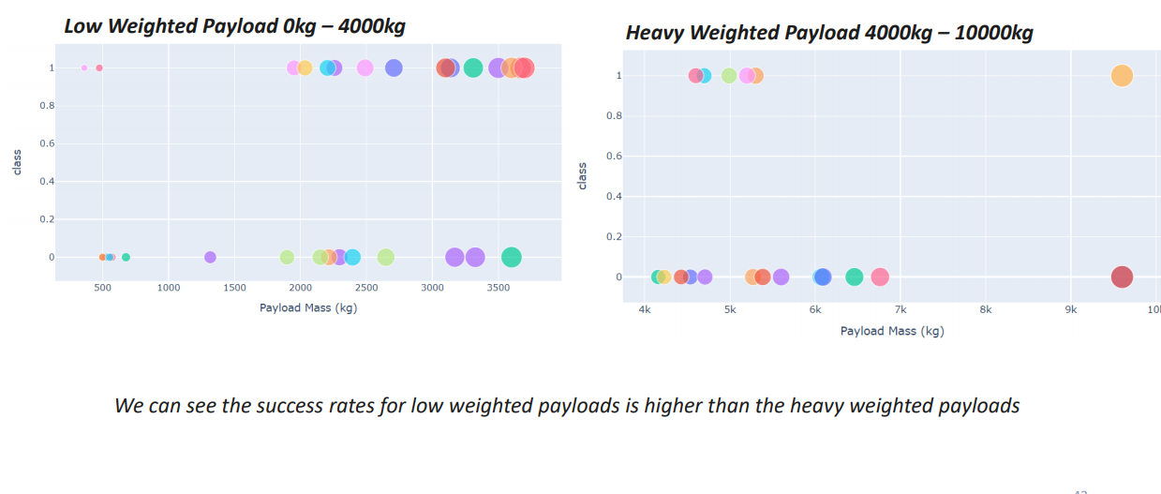
<Dashboard Screenshot 3>
Replace <Dashboard screenshot 3> title with an appropriate title
Show screenshots of Payload vs. Launch Outcome scatter plot for all sites, with different payload selected in the range slider
Explain the important elements and findings on the screenshot, such as which payload range or booster version have the largest success rate, etc.

Slide 45


Slide 46
Classification Accuracy
Method | Accuracy
Logistic Regression | 0.8333333333333334
SVM | 0.8482142857142856
Decision Tree | 0.8767857142857143
KNN | 0.8333333333333334

Slide 47
Confusion Matrix
Show the confusion matrix of the best performing model with an explanation
The TP / TP + FP = 12 / 15 = 0.8 (Precision)
The TP / TP + FN = 1 (Recall)
The f1-score is pretty good in this case, with only 3 false positive, where the model predicted successful landing, but in reality it failed

Slide 48
Conclusions
Decision Tree in this example is the best ML with an accuracy of 87.7% on test dataset
Low weighted payloads perform better than heavier payloads
The success rate of SpaceX improve with time from 2010-2020
Orbit GEO, HEO,SSO and ES-L1 has the best successful rate
KSC LC-39A had the most successful launches

Slide 49
Appendix
They are all in the GitHub

Slide 50


